Slide 1

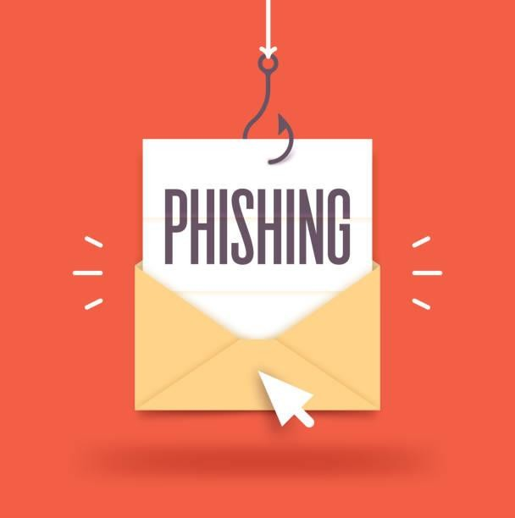

Phishing Awareness Training
Phishing is a type of cybercrime where attackers use fraudulent emails or messages to trick victims into revealing sensitive information or downloading malware. This training module will provide you with the knowledge and tools to identify and protect against phishing attempts.
Garv Pankaj

Slide 2

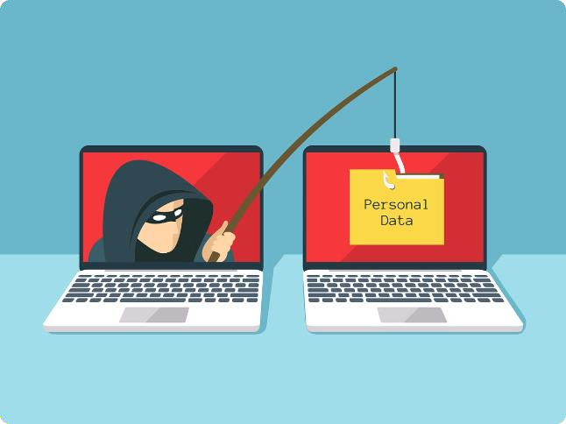
What is Phishing?
1
Deceptive Tactics
Phishing scams use social engineering techniques to manipulate people into disclosing login credentials, financial information, or downloading malware.
2
Impersonation
Phishers often impersonate trusted organizations or individuals to make their messages appear legitimate and gain the victim's trust.
3
Widespread Threat
Phishing attacks are a common and growing threat, affecting individuals,
businesses, and institutions worldwide.

Slide 3
Common Phishing Tactics
Urgent Requests
Fake Offers
Malicious Links
Phishers create a sense of urgency, claiming there's an issue with your account or a need to act immediately.
Scammers offer fake prizes, discounts, or special deals to entice victims to provide personal information.
Phishing emails often contain links that lead to fake websites designed to steal your login credentials or install malware.

Slide 4
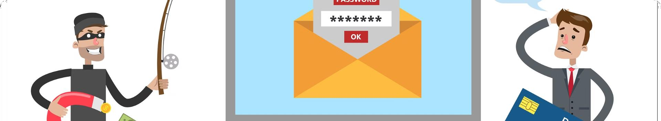
Identifying Phishing Attempts
1
Sender Verification
Check the sender's email address and ensure it's from a legitimate source, not a lookalike domain.
2
Suspicious Links
Hover over any links in the email to verify the destination URL before clicking.
3
Unexpected Requests
Be wary of messages asking for sensitive information or urgent action that seem out of the ordinary.
4
Poor Grammar
Phishing emails often have grammatical errors, typos, or poor formatting that indicate they're not from a reputable source.

Slide 5

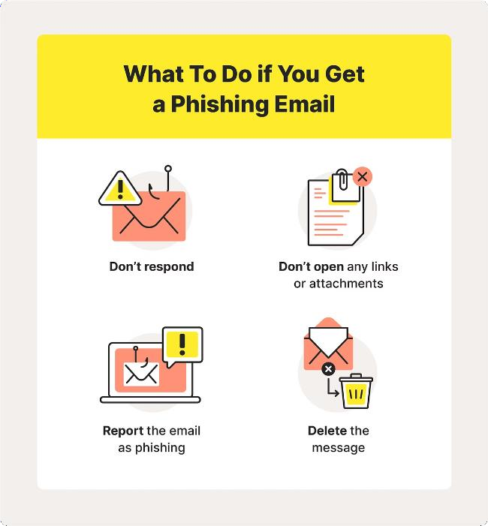
Protecting Yourself from Phishing
Be Cautious
Approach all unsolicited messages and requests for information with skepticism.
Verify Sources
Contact the organization directly using known, legitimate contact information to confirm the validity of any requests.
Use Security Tools
Employ anti-virus software, spam filters, and other cybersecurity measures to detect and block phishing attempts.
Stay Informed
Regularly educate yourself on the latest phishing tactics and best practices for keeping your information safe.

Slide 6


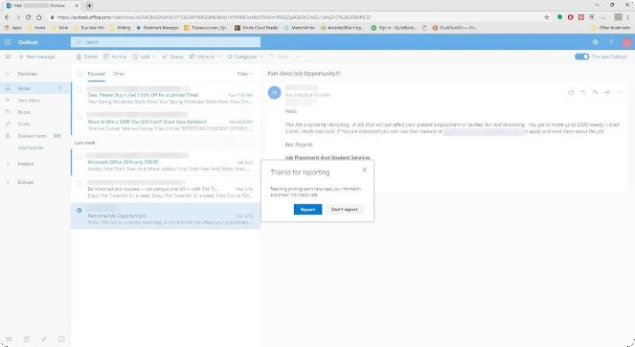


Reporting Suspected Phishing Incidents
Forward Email
Forward any suspected phishing emails to your organization's security team or the relevant authorities.
Contact Support
Immediately report any successful phishing attempts or compromised accounts to your organization's IT or security department.
File a Complaint
Consider reporting the incident to the FTC, FBI, or other relevant agencies to help combat the wider phishing problem.

Slide 7

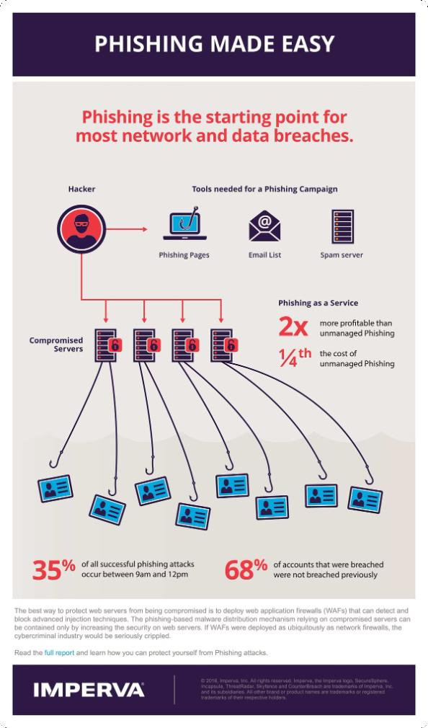

Best Practices for Phishing Prevention
Employee Training
Regularly educate your workforce on phishing awareness and best practices.
Robust Security Measures
Implement strong email filters, multi-factor authentication, and other
security controls to protect against phishing attacks.
Incident Response Plan
Develop a clear plan for quickly identifying, reporting, and responding to suspected phishing incidents.

Slide 8

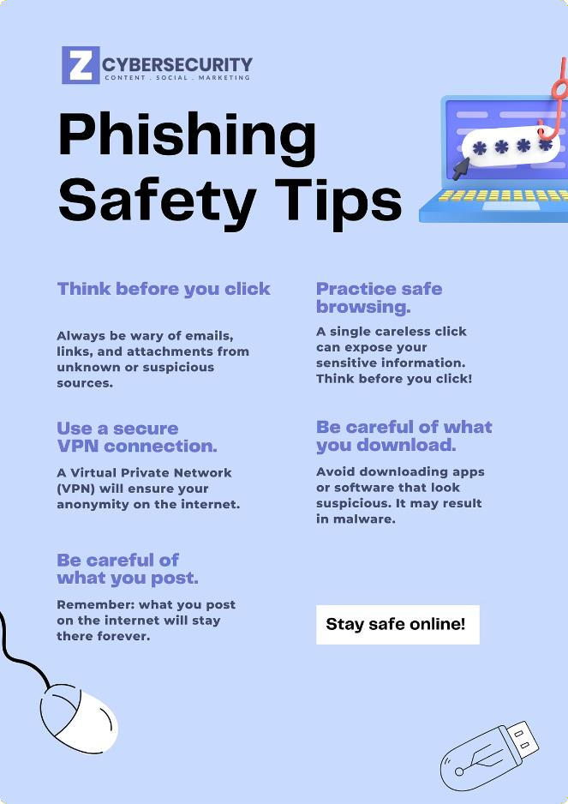
Conclusion and Key Takeaways
Be Vigilant | Approach all unsolicited messages with caution and verify the source before taking any action.
Stay Informed | Continuously educate yourself and your organization on the latest phishing tactics and best practices.
Report Incidents | Immediately report any suspected phishing attempts or successful attacks to the appropriate authorities.
Strengthen Security | Implement robust security measures and incident response plans to prevent and mitigate the impact of phishing attacks.

